Slide 1
FLIPAKART REVIEW SENTIMENTAL ANALYSIS USING PYTHON
Samiya Sadiq

Slide 2
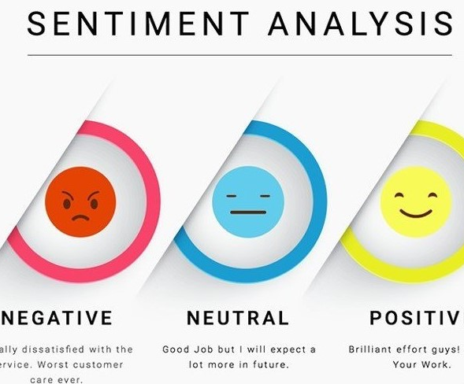



Agenda
What is Sentimental Analysis?
Why use Sentimental Analysis And Applications of Sentimental Analysis
Flipkart review Sentimental Analysis

Slide 3
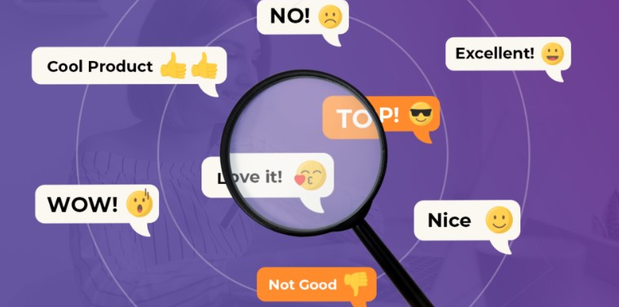

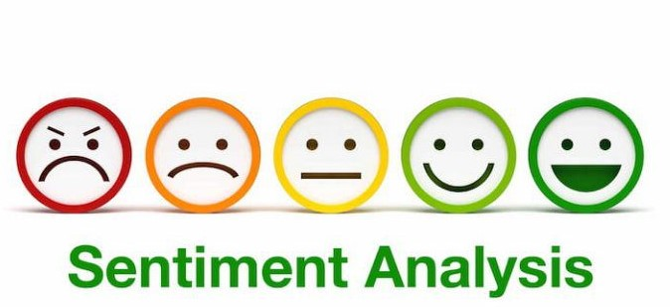
What is Sentimental Analysis
As we know sentiments are feelings, likes/dislikes, good/bad etc. Sentimental Analysis also knows as opinion mining, is a natural language processing (NLP) used to determine whether data is positive, negative or neutral. We can say sentimental analysis is the process of detecting positive or negative sentiments in text. It is often used in business to understand customers.
Some benefits of sentimental Analysis are:
Social media Sentimental Analysis
Improve Customer Service
Multilingual Insights
News Trend Analysis Online Reputation Analysis

Slide 4
Why use Sentimental Analysis?
Application Of Sentimental Analysis
Social Media Monitoring
Ads Placement
Business and Organization
Product Analysis
Reputation Management
Market Research
Automatically evaluating customer feedback, such as survey replies and social media dialogues, enables companies to understand what makes consumers happy or upset, allowing them to customize products and services to their customer’s requirements.

Slide 5
Flipkart Review Sentimental Analysis Using Python
In this task, we are required to analyze the sentiments on the Flipkart dataset. In this dataset there are two columns:-
Reviews: given by the customer, a combination of sentences and emojis
Ratings: It is the number of stars given by the customer, a maximum rating is observed to be five.

Slide 6
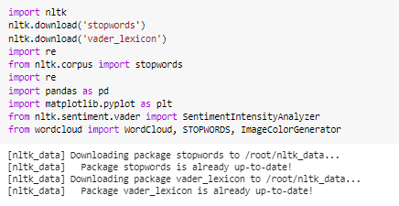
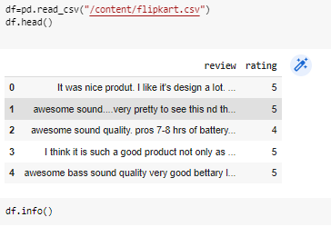

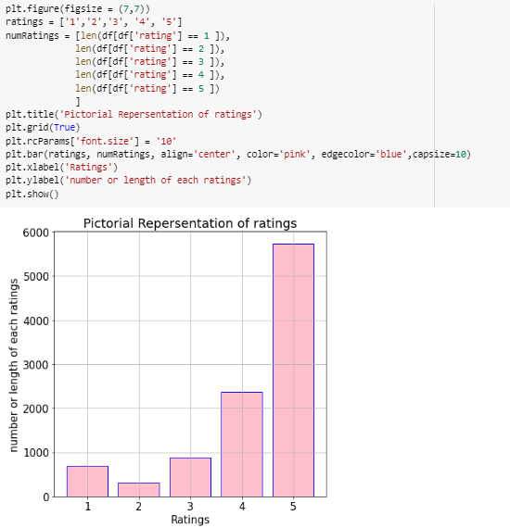
1. Importing required libraries and reading
our dataset.
2. Check if any missing values. This dataset has no null values
3. Plotting to number of rating and rating for each
of the ratings.

Slide 7
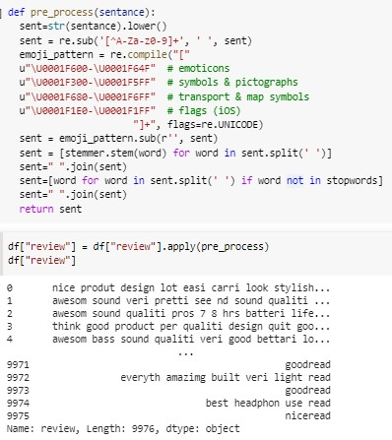
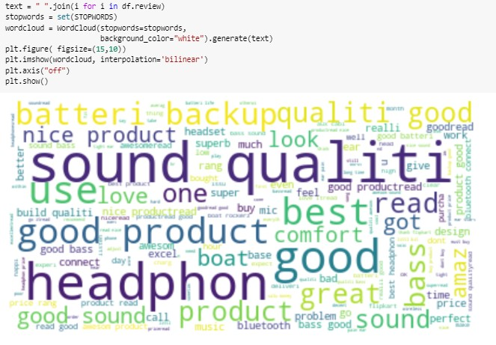
4. Preprocessing the dataset (review column)Here, first removing any data except 0..9, a..z and A..Z, removing emojis and then stemming the words and removing stop words. Stemming is the process of reducing a word to its base word such that similar words kind lie under a common stem. Snowball Stemmer is used it has a few rules like ily-ili, ly-nil, etc. Stop words are those words in natural language that have very little meaning like a the, is, etc.
5. Now, let's create a word cloud to visualize the most used words.

Slide 8
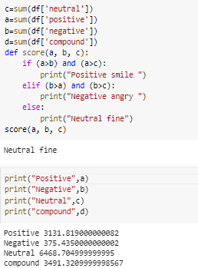
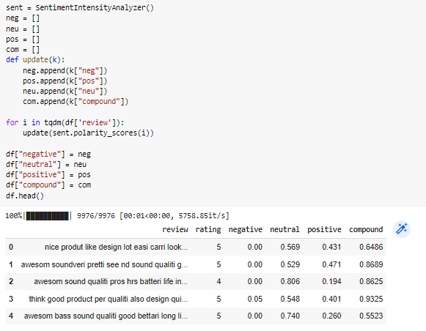
Now, using VADER’s SentimentIntensityAnalyzer(), it takes strings and returns data in any of the four categories (positive, negative, neutral and compound). VADER is (Valence Aware Dictionary for Sentiment Reasoning) is a model used for text sentiment analysis that is sensitive to both polarity and intensity of emotion.

Slide 9

Samiya Sadiq
samiyasadiq2002@gmail.com
THANK YOU
Dataset
Github
About Sentiment Anaylsis
SentimentIntensityAnalyzer()

